Slide 1
An Overview of Deep Learning Based Object Detection Techniques

Slide 2
CONSIST
I. INTRODUCTION
II. TECHNIQUES EMPLOYED
III. APPLICATIONS OF OBJECT DETECTION
IV. COMPARATIVE STUDY
V. SCOPE OF OBJECT DETECTION
VI. CONCLUSION

Slide 3
1.
INTRODUCTION

Slide 4
Computer vision consists of four parts, classification, positioning, detection and segmentation.

Slide 5
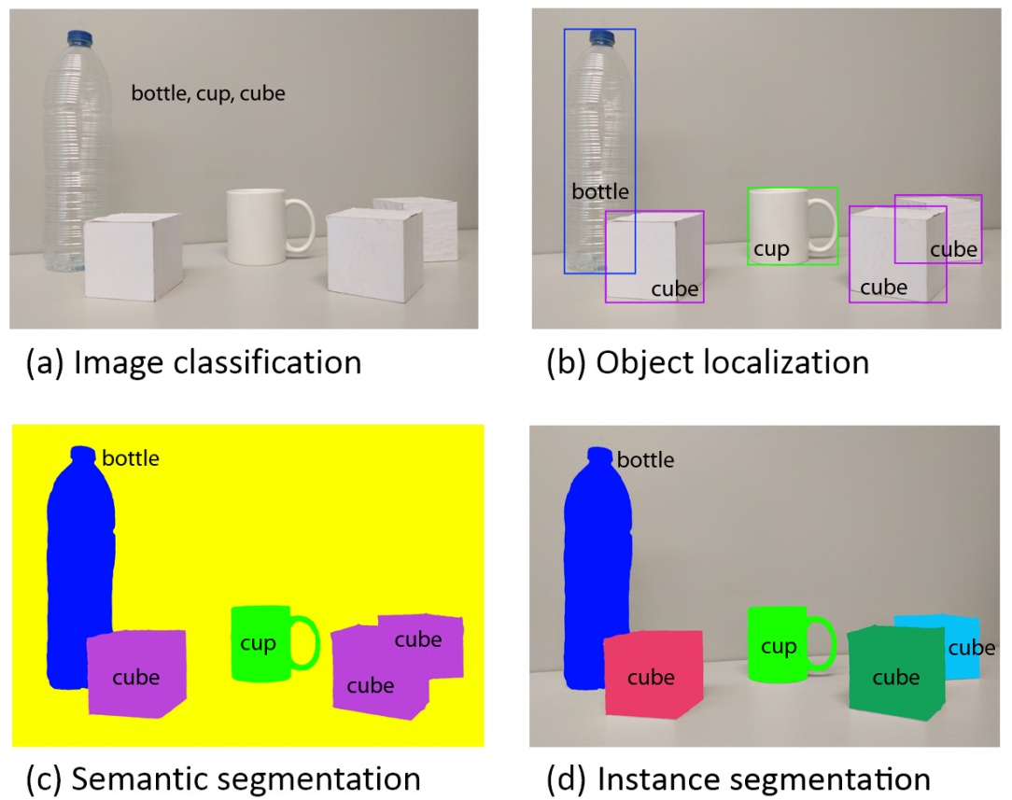

Slide 6
TECHNIQUES EMPLOYED

Slide 7
Sliding Window
Advantages：Simple and Easy to implement
Limitations：Time consuming

Slide 8
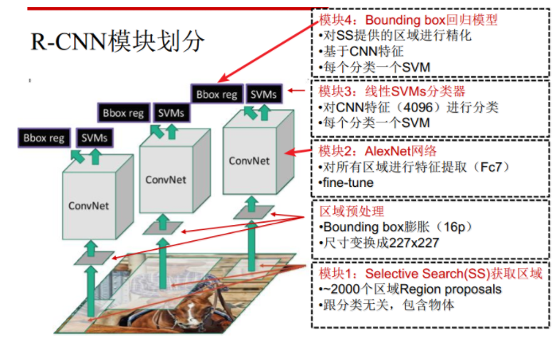
R-CNN
Advantages：Number of regions proposed is less as compared with sliding window technique.
Limitations：Multi-stage training
Expensive training in terms of
space and time
Slow object detection

Slide 9
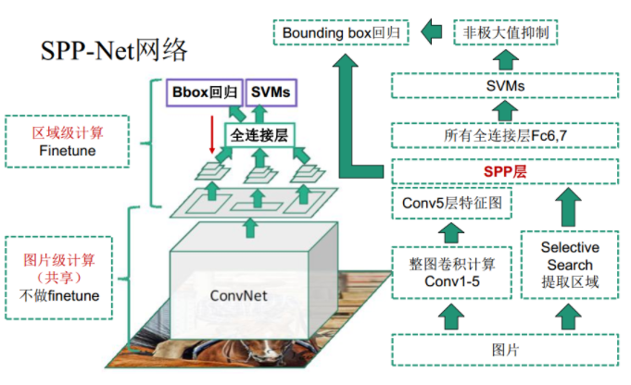
SPP-net
Advantages：Faster than R-CNN
Avoid repeated computation of features.
Limitations：Reduced accuracy for very deep neural network.

Slide 10
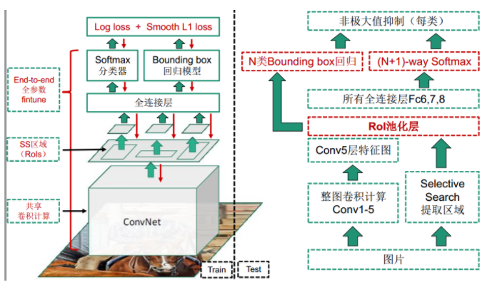
Fast R-CNN
Advantages：High quality detection than SPPnet and R-CNN.
Single stage training.
Limitations：Slow clustering.
Selective search is slow so still
high computation time.

Slide 11
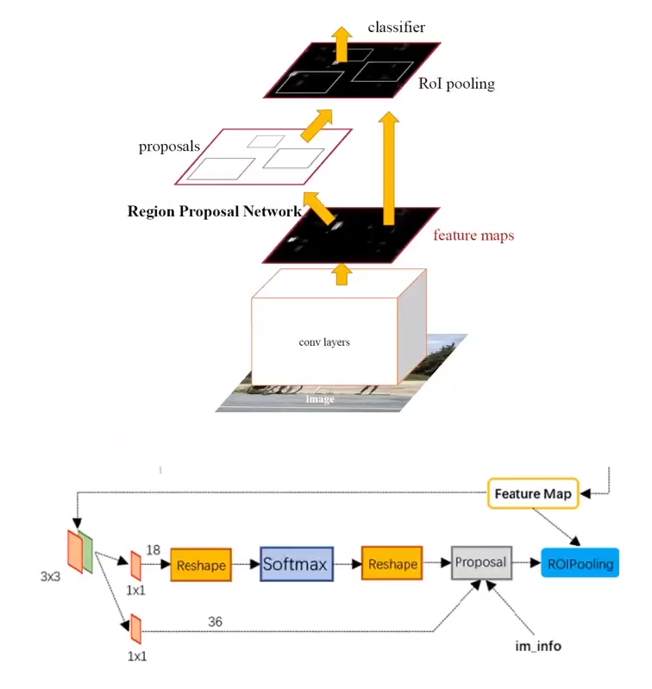
Faster R-CNN (RPN+Fast R-CNN)
Advantages：Faster than fast R-CNN.
Limitations：Slow object proposal.
Slow implementation than
YOLO.

Slide 12
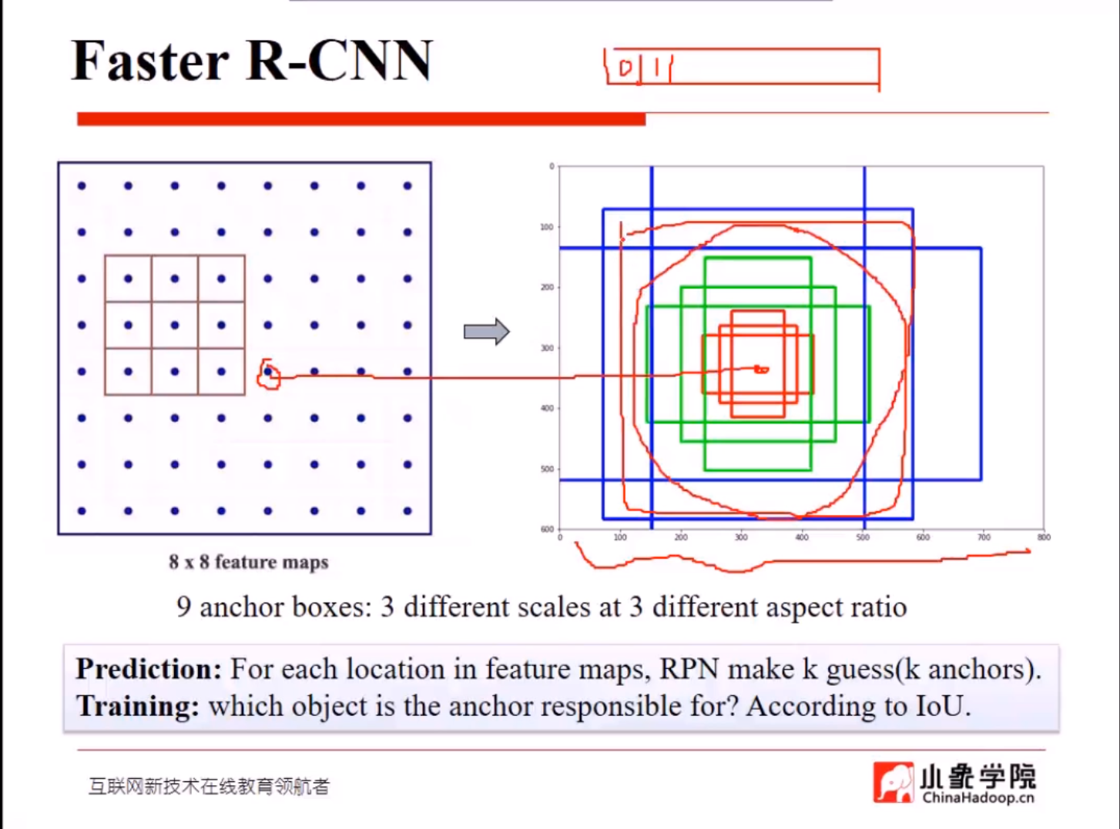
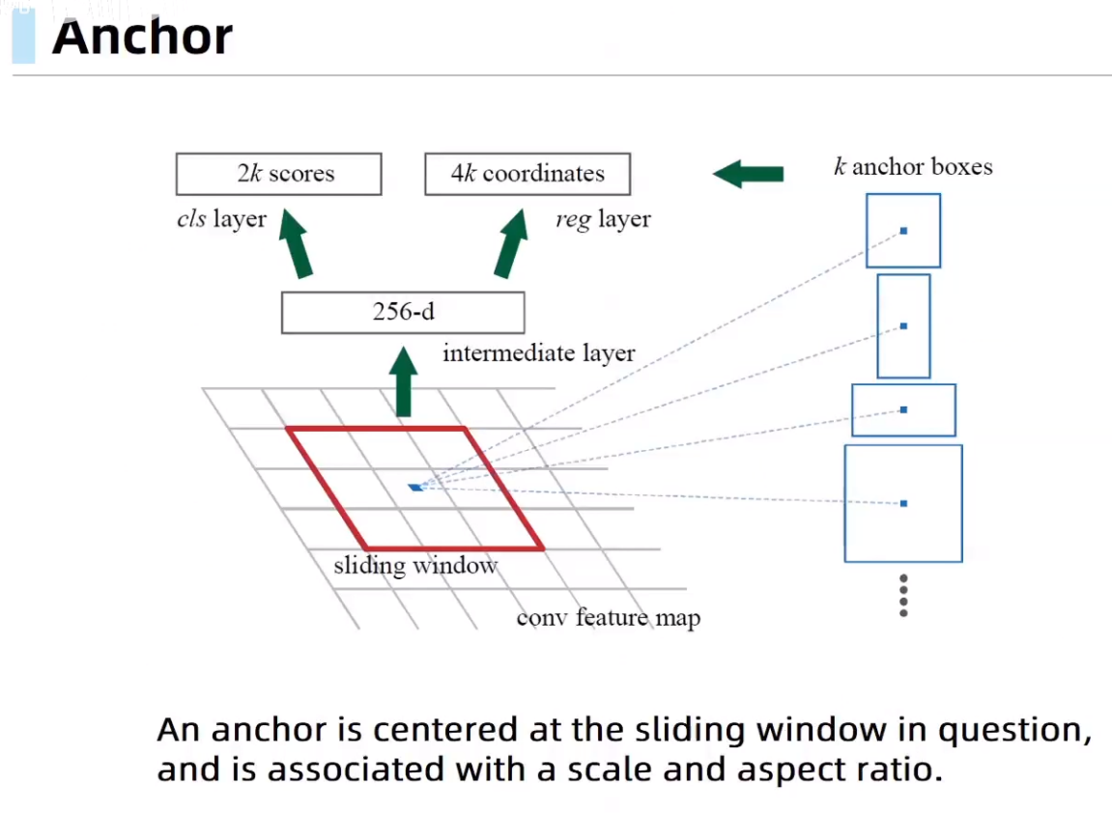
Faster R-CNN (RPN+Fast R-CNN)

Slide 13
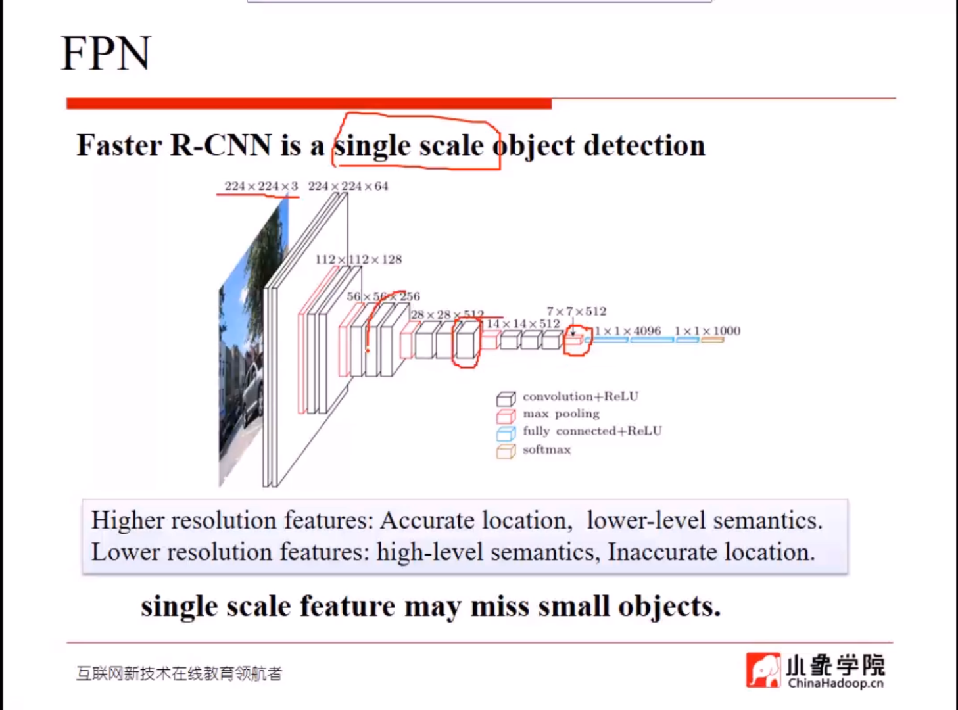
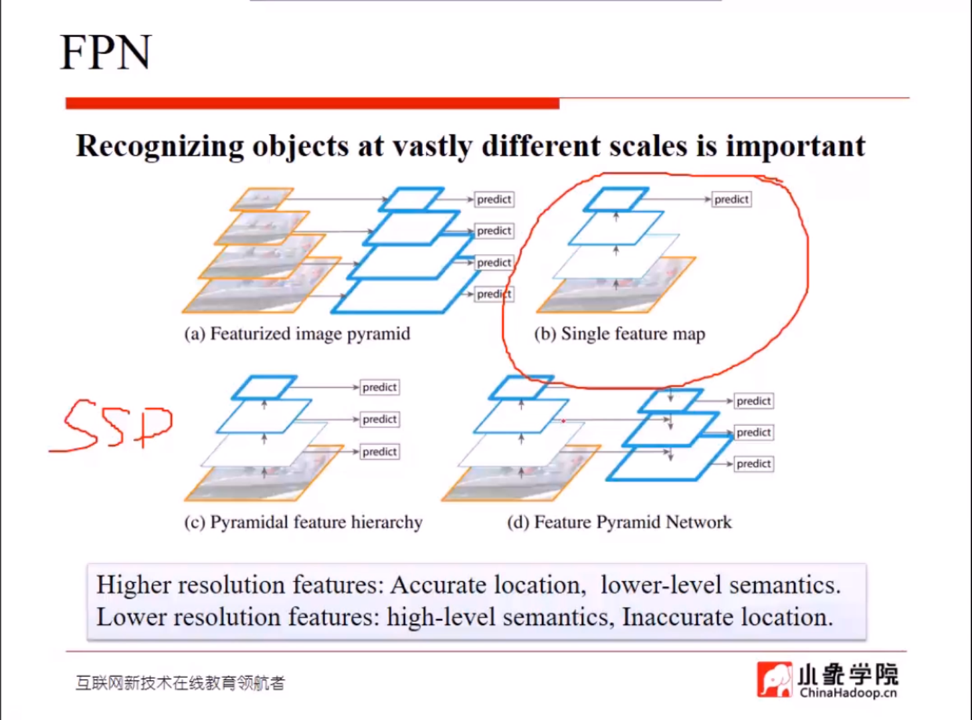
FPN
Advantages：Rich semantics in all levels
Limitations：Removing top-down connection reduce accuracy.

Slide 14
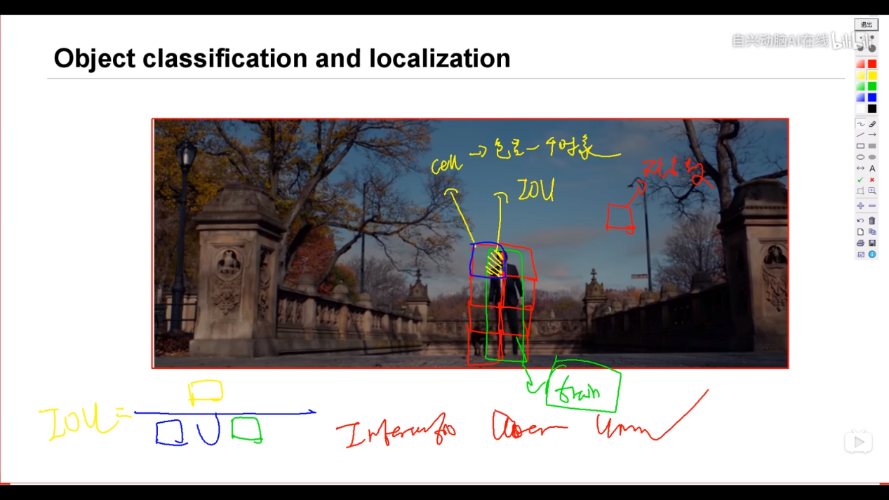
YOLO
Advantages：Efficient unified object detector.
Extremely fast.
Less amount of background
errors than fast R-CNN.
Limitations：Can’t detect multiple objects within the same grid.
Loss in accuracy rate.
Possibility to detect one object.
multiple times.
Unable to localize small size objects.

Slide 15
III. APPLICATIONS OF OBJECT DETECTION
Object detection is a current trending area having a wide range of applications over different fields.
A. Face detection.
B. Vehicle detection.
C. People counting.
D. Security and surveillance.

Slide 16
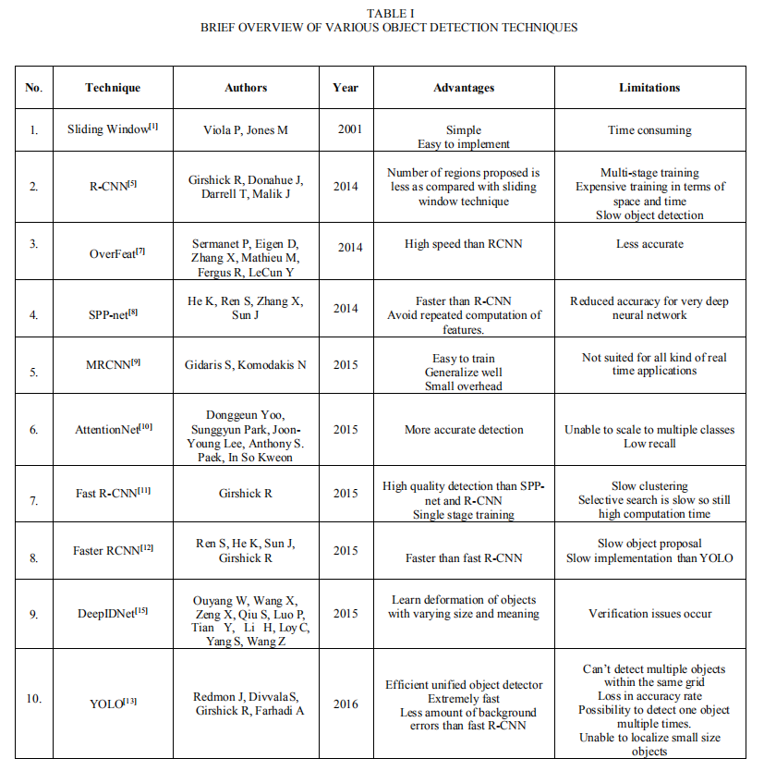
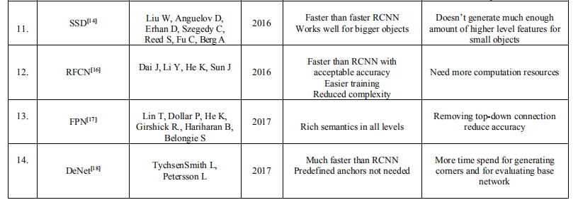
IV. COMPARATIVE STUDY

Slide 17

V. SCOPE OF OBJECT DETECTION
Recent years have observed a tremendous refinement in
the domain of object detection especially over remote sensing images. As the quantity and the quality of the remote sensing
images have increased, it leads to both opportunities and challenges in this field.

Slide 18
VI. CONCLUSION
This review provides a short and crisp idea about different object detection techniques and lists the highlights and challenges of each. The work also concentrates on the various applications of object detection. Apart from this, the paper also mention the promising future of object detection in the field of remote sensing images.

Slide 19

Thanks

